Slide 1
UNIT:IV
MANAGEMENT IN CLOUD COMPUTING & SECURITY

Slide 2
Cloud data centers
Energy efficiency in data centre
Data Management in Cloud Computing
Mobile cloud computing service models
Open Source and Commercial Clouds
Cloud Simulator
sensor cloud
Fundamental Cloud security
Cloud security Threads
Additional considerations
Security solutions a case study
CLOUD COMPUTING FOR EVERYONE

Slide 3
DATA CENTER
Introduction

Slide 4
Why Microsoft Has Underwater Data Centers
https://www.youtube.com/watch?v=LmfvUiJ6tB8

Slide 5
Google Data Center Security: 6 Layers Deep
https://www.youtube.com/watch?v=kd33UVZhnAA

Slide 6
A data center - also known as a data center or data center - is a facility made up of networked computers, storage systems, and computing infrastructure that businesses and other organizations use to organize, process, store large amounts of data. And to broadcast. A business typically relies heavily on applications, services, and data within a data center, making it a focal point and critical asset for everyday operations.

Slide 7
WHAT IS A DATA CENTER
Data centers provide a range on information technology services
 These services include:
 Email
 Data storage and management
 Web hosting
 Application Hosting

Slide 8

WHAT IS A DATA CENTER
 Data centers are designed to house information systems and related components such as:
 Servers
 Routers
 Storage
 Uninterruptable power
supplies (UPS)
 Cooling Units
 Power Distribution Unit (PDU)
 Data centers have unique and typically large power requirements
 They are often raised floor designs to accommodate the large amount of cables required.

Slide 9

DATA CENTER BENEFITS
 Economies of Scale
 Purchasing savings based on large purchases
 Dedicated IT staff
 Shared resources
 Security
 Physical
 Limited access to servers
 Surveillance
 Virtual
 Firewalls
 Anti-virus
 Password Protection

Slide 10
Tier Leve l | Data center classification
1 | Single non-redundant distribution path serving the IT equipment Non-redundant capacity components Basic site infrastructure guaranteeing 99.671% availability
2 | Fulfills all Tier 1 requirements Redundant site infrastructure capacity components guaranteeing 99.741% availability
3 | Fulfills all Tier 1 and Tier 2 requirements Multiple independent distribution paths serving the IT equipment All it equipment must be dual-powered and fully compatible with the topology of a site’s architecture Concurrently maintainable site infrastructure guaranteeing 99.982% availability
4 | Fulfills all Tier 1, Tier 2, and Tire 3 requirements All cooling equipment is independently dual-powered, including chillers and heating, ventilation and air-conditioning (HVAC) systems Fault tolerant site infrastructure with electrical power storage and distribution facilities guaranteeing 99.995% availability

Slide 11
WHAT DO THESE CLASSIFICATIONS MEAN?
Availability | Downtime/year
Tier 1: 99.671% | 28 hours
Tier 2: 99.741% | 22 hours
Tier 3: 99.982% | 1.5 hours
Tier 4: 99.995% | 26 minutes
“Businesses lose an average of about
$5,000 per minute in an outage.”
$300,000 per hour.

Slide 12
DATA CENTER VS. CLOUD
 Data Centers
 Require specialized equipment and knowledge
 Owner maintains complete control over hardware and software
 Highly customized
 Component of a cloud
 Cloud computing offers computing as a utility service
 Self service, Pay per use
 Platform independent
 Requires no specialized knowledge in computing
 Often represents outsourcing as a Risk Transference Strategy
 Composed of many data centers

Slide 13
DATA CENTER VS. CLOUD
In simple terms:
 “Think of it as taking a taxi vs. buying a car to make a trip between San Francisco and Palo Alto. If you only make the trip once a quarter, it is cheaper to take a taxi. If you make the trip every day, then you are better off buying a car. The difference is the duty cycle. If you are running infrastructure with a duty cycle of 100%, it may make sense to run in-house.”

Slide 14
CLOUD SERVICES
Types of service offered
 Infrastructure as a service (IaaS) ex. Servers, Networking, etc.
 Platform as a service (PaaS) ex. Windows, Red Hat, etc.
 Application or Software as a service (SaaS) ex. Email, Oracle, MSWord etc.

Slide 15
DATA CENTER COMPONENTS: LOCATION
Important considerations
 Frequency of conditions likely to result in disaster situations
 Distance from energy source
 Reliability of energy source
 Climate
 Choosing a location with a cool, mild climate, provides the possibility of a
data center that does not require air conditioning units.

Slide 16
DATA CENTERS
 Microsoft Tour
 http://www.globalfoundationservices.com/infrastructure/videos.html
 Purdue Data Centers
 Research Computing Cluster Steele http://www.rcac.purdue.edu/userinfo/resources/steele/userguide.cfm
 Currently housed in a HP Pod container http://www.flickr.com/photos/vax-o-matic/sets/72157624103673857/
 ITAP Data Centers Service Catalog http://www.itap.purdue.edu/service/catalog/alpha/
 Cisco Richardson Interactive data center tour
 http://www.cisco.com/web/about/ciscoitatwork/data_center/flash/dc_experienc e/rdc_tour.html

Slide 17
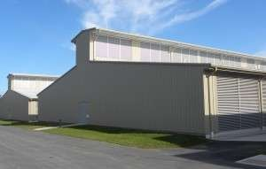
DATA CENTER COMPONENTS: BUILDING
 The building is important because it will effect the efficiency of the data center
 There are many ways to have an efficient building
 Yahoo Chicken Coop
 Designed to take advantage of “free cooling”
 PUE 1.1

Slide 18
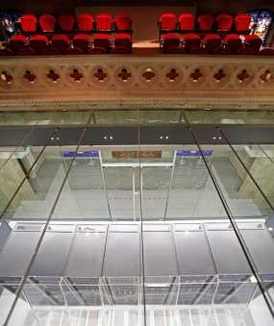
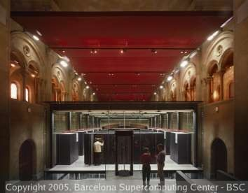
DATA CENTER COMPONENTS: BUILDING (CONTINUED)
 Mare Nostrum “Divine Data Cruncher”
 Data Center in a Barcelona Cathedral
 PUE 1.3

Slide 19
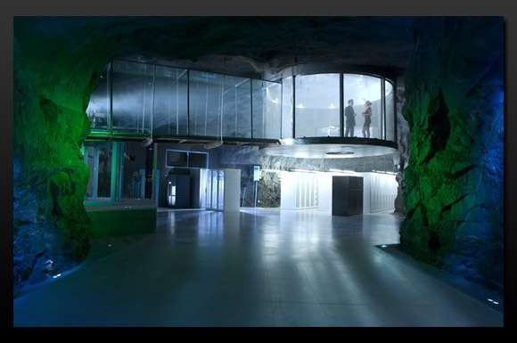
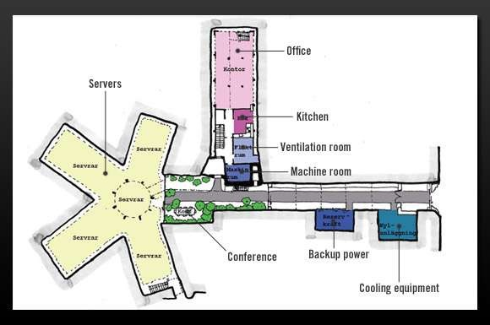
DATA CENTER COMPONENTS: BUILDING (CONTINUED)
 “The Spy Who Loved Me” Bunker
 Stockholm converted nuclear bunker
 Designed to take advantage of
“free cooling”
 PUE 1.1

Slide 20
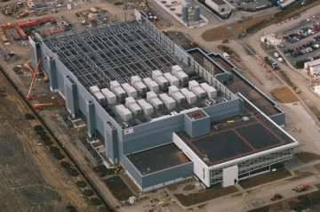
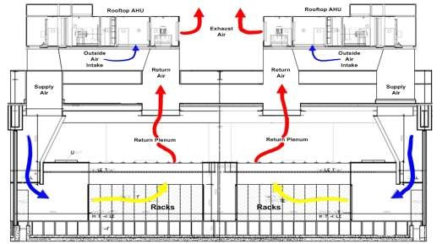
DATA CENTER COMPONENTS: BUILDING (CONTINUED)
 Microsoft Dublin data center
 Designed to take advantage of Ireland’s ambient temperatures for “free cooling” us airside economizers
 Uses shipping container to create modularization to facilitate
future expansion
 PUE 1.25
low
ing

Slide 21
DATA CENTER COMPONENTS: COOLING
 Servers create heat
 Historically servers have been susceptible to heat damage
 According to James Hamilton of Amazon the average exhaust from servers is 115 degrees Fahrenheit
 Approximately half of the power consumed in the data center is used in cooling
 Cooling Options
 Computer Room Air Conditioning (CRAC)
 Liquid Cooling
 Air Side Economizers

Slide 22
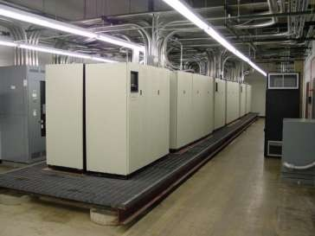
DATA CENTER COMPONENTS: UPS
 Uninterruptable Power Supply (UPS)
 Conditions power
 Provides power to avoid outages during power failure lasting seconds or minutes
 Provides time to shutdown, failover, or initiate backup power for longer
outages
 Traditional data center UPS
 The pictured UPS will provide 80 minutes of power. Typical is about 15 min
 Double conversion
 These are often comprised of multitudes of batteries.
 Batteries are better for longer outages,
many short outages will reduce the life of a
battery based UPS
utes.

Slide 23
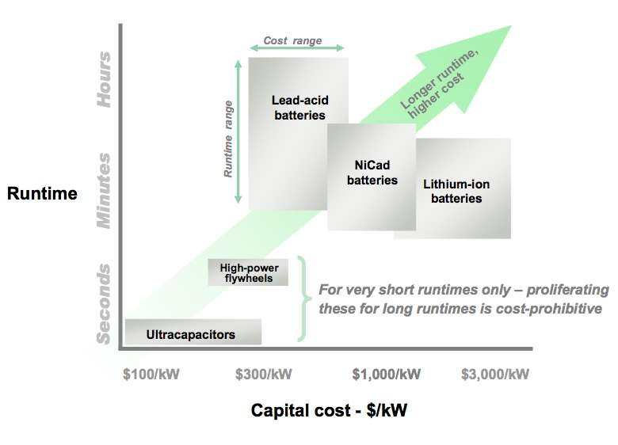
DATA CENTER COMPONENTS: UPS (CONTINUED)
 Alternatives to battery based UPS
 Flywheel
 Rotary
 Ultracapacitor
 The non-battery options
are useful for situations wi Numerous short outages
 Ultracpacaitors require
little maintenance and are advantageous in unmann remote sites.
th
ed,

Slide 24
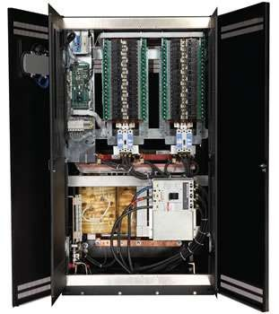
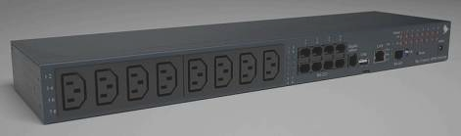
POWER DISTRIBUTION UNIT (PDU)
 Transforms the voltage to standard voltage for distribution
 480V to 120V or 277V
 Distributed via power outlets
 Provides power monitoring and additional power conditioning
 Types of PDU
 Panel
 Room
 Rack

Slide 25
DATA CENTER COMPONENTS: BACKUP POWER
 Grid-based additional power service provider
 Batteries
 Diesel generators
Backup power has traditionally been a requirement for maintaining uptime for tiered facilities. Some larger organizations are able to compensate for outages by rerouting traffic to working nodes.

Slide 26

Energy Efficient Data Centers

Slide 27
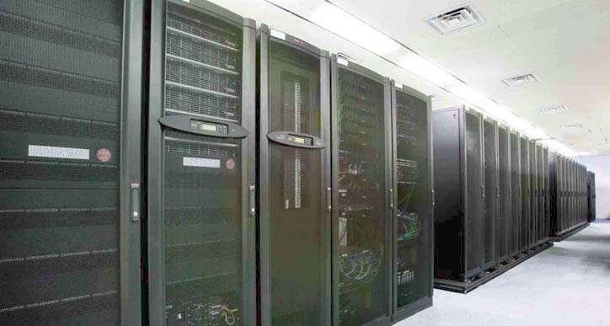
Why Data Centers?
Data centers are highly energy intensive and growing at a rapid rate
- Consume 10 to 100 times more energy per square foot than typical office building
Data centers consumed about 45 billion kWh in 2005 and 61 billion kWh in 2006
- This accounts for nearly 1.2% and 1.5% of all U.S. electricity respectively
At current rate, power requirements for data centers could double in 5 years
2

Slide 28


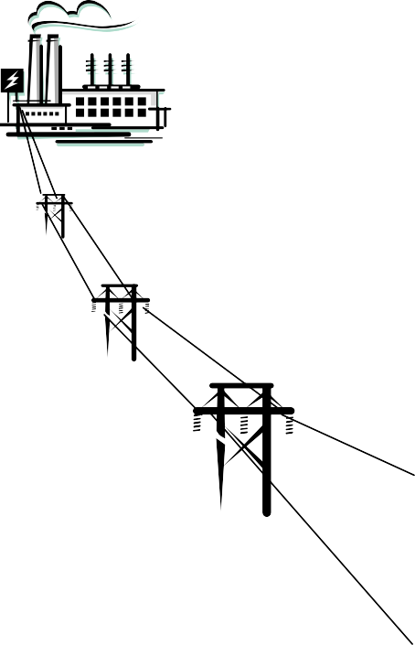
Typical Data Center Energy Use
Power Conversions
& Distribution
100
Units
35 Units
Cooling Equipment
Server Load
/Computing Operations
33 Units Delivered
3

Slide 29
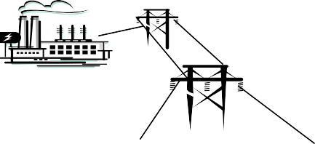
Energy Efficiency Improvement Opportunities
Better air management
Move to liquid cooling
Optimized chilled-water plants
Use of free cooling
Load management
Server innovation
Power Conversion & Distribution
Server Load/ Computing Operations
Cooling Equipment
High voltage distribution
Use of DC power
Highly efficient UPS systems
Efficient redundancy strategies
On-site generation
CHP applications
Waste heat for cooling
Use of renewable energy
Alternative Power Generation
Fuel cells
4

Slide 30
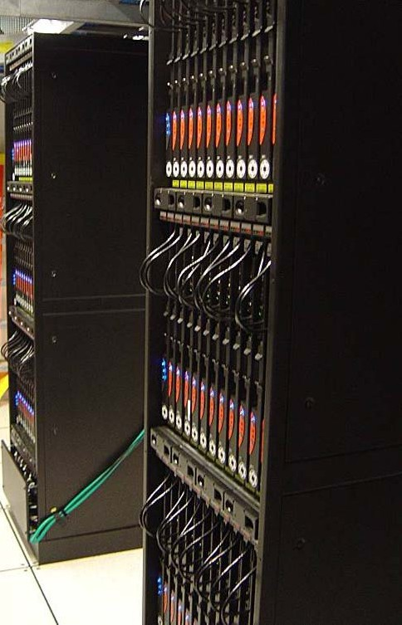
Potential Benefits
Save 20 billion kWh per year by 2015
  Equivocates to savings of nearly $2 billion
  About equal to annual electricity use in 1.8 million American homes
Potentially defer need to build 2,300 MW of new generating capacity
  Avoiding 3.4 million metric tons of carbon emissions (like taking 675,000 cars off the road)
Extend life and capacity of existing data center infrastructures

Slide 31


EERE Team
Industrial Technologies Program Save Energy Now
Create DC Pro tool, best practices and training
Work with industry to develop common metrics
Develop and demonstrate best available technologies
Federal Energy Management Program
Raise awareness of Federal facility and IT managers to opportunities to increase data center energy efficiency
Encourage deployment of the Save Energy Now tools, best practices
Sponsor training workshops

Slide 32
Many areas can be improved…
Cooling
Air Management
Free Cooling – air or water
Environmental conditions
Centralized Air Handlers
Low Pressure Drop Systems
Fan Efficiency
Cooling Plant Optimization
Direct Liquid Cooling
Right sizing/redundancy
Heat recovery
Building envelope
Electrical
UPS and transformer efficiency
High voltage distribution
Use of DC power
IT
Power supply efficiency
Standby/sleep power modes
IT equipment
Right sizing/redundancy
fans
Virtualization
Lighting – efficiency and_{ Load shifting}
controls
Standby generation On- site generation
Premium efficiency motors
Memory management and efficiency

Slide 33
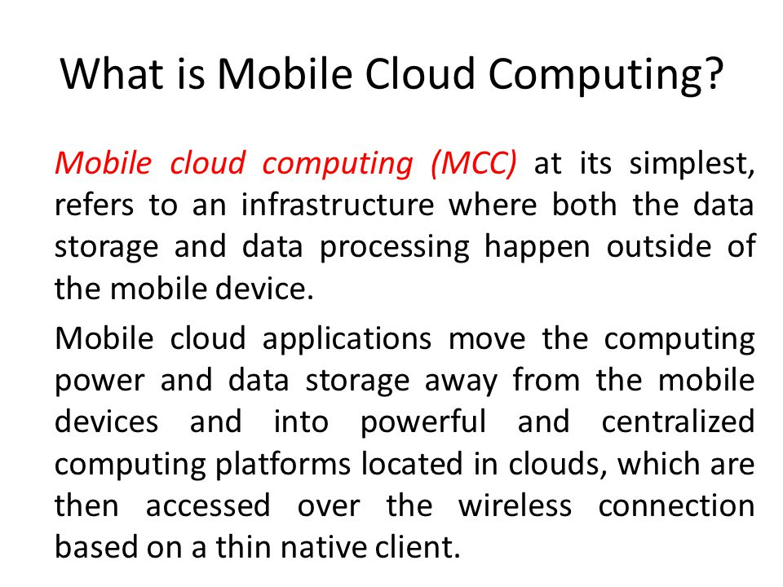

Slide 34
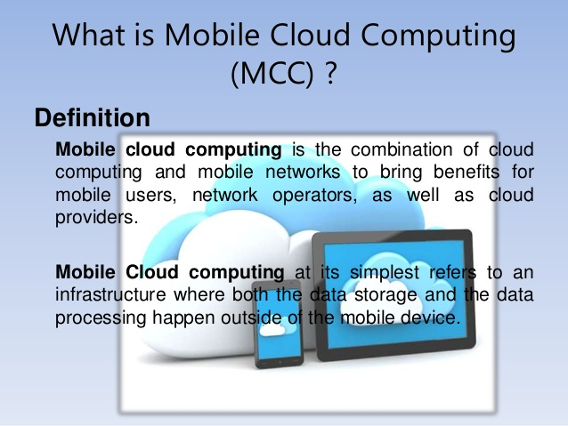

Slide 35
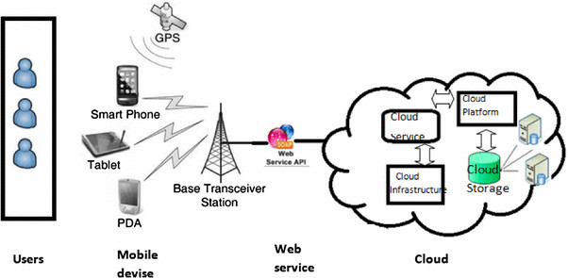
Mobile cloud computing

Slide 36
